Slide 1

Lovable.dev: Idea to Prototype, Faster
An AI Demonstration by Jeremy Gatens
Notes:
AI-generated content may be incorrect. --- Welcome to this presentation on the vital role of AI within the Penn HR landscape. Today, we’ll explore how AI can open up opportunities while also highlighting our responsibilities in its implementation. Let’s dive into the transformative potential of AI for human resources.

Slide 2
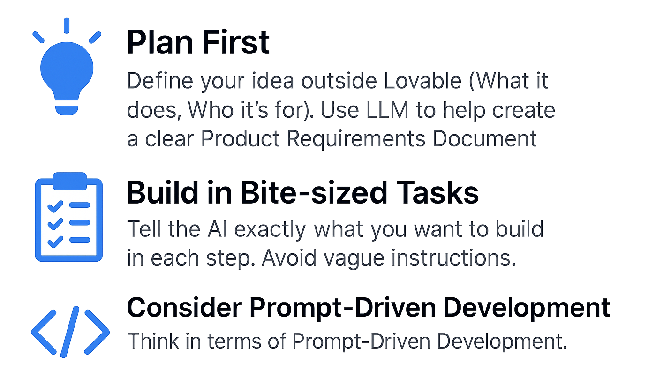
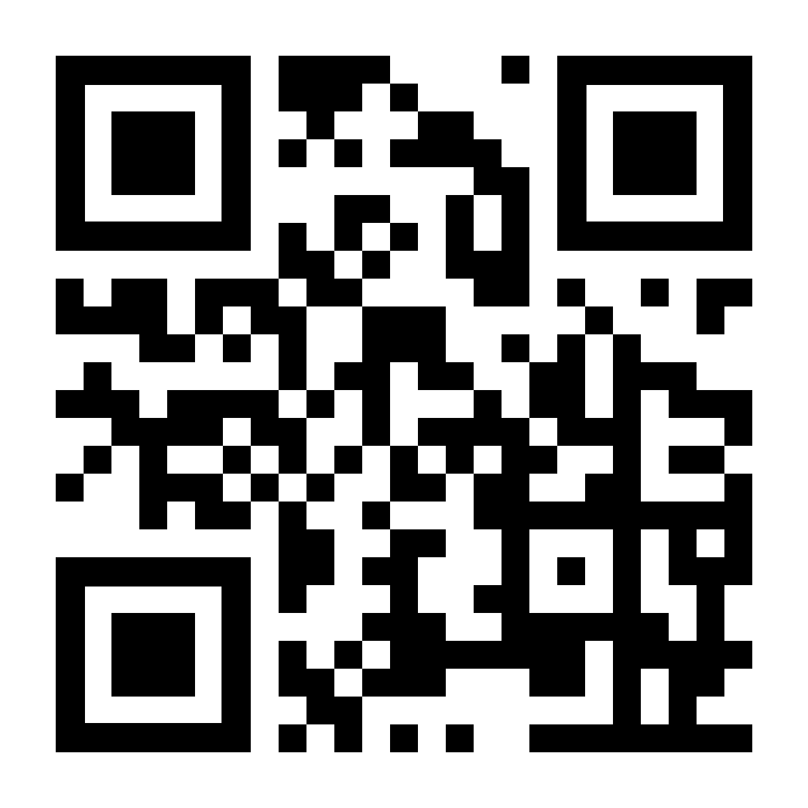
ABCs of Modern Development
lovable.dev
Notes:
--- This slide references information from the following file: https://penno365-my.sharepoint.com/personal/jgatens_upenn_edu/_layouts/15/Doc.aspx?sourcedoc=%7B86AF1ADD-D25E-4B4C-A9D7-83DF74FCA3FC%7D&file=Revised%20Senior%20HR%20Leadership%20AI%20Talk%20Meeting%20Outline%2004072025.docx&action=default&mobileredirect=true&DefaultItemOpen=1 Objective Today: To establish a shared understanding of AI's relevance to HR and initiate dialogue on a deliberate investment strategy. Connects to: "AI in HR offers potential however it must be approached with caution, transparency, & inclusivity."

Slide 3
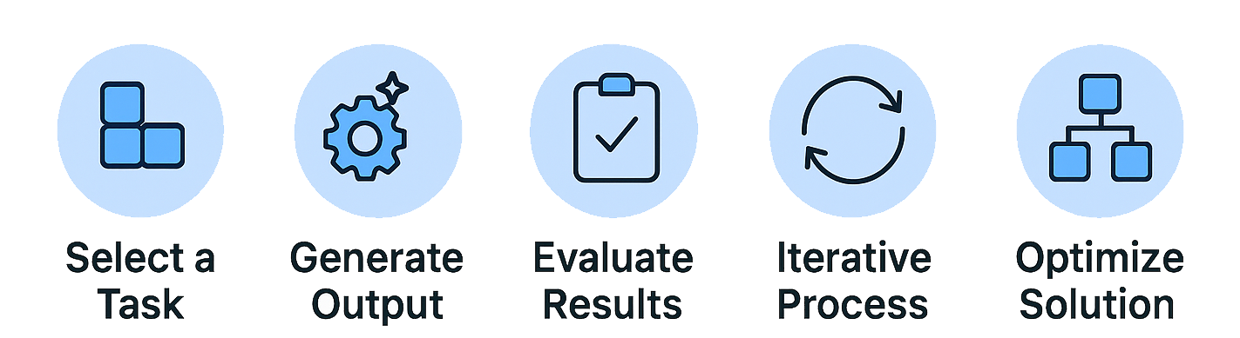
Prompt-Driven Development
Notes:
--- This slide references information from the following file: https://penno365-my.sharepoint.com/personal/jgatens_upenn_edu/_layouts/15/Doc.aspx?sourcedoc=%7B86AF1ADD-D25E-4B4C-A9D7-83DF74FCA3FC%7D&file=Revised%20Senior%20HR%20Leadership%20AI%20Talk%20Meeting%20Outline%2004072025.docx&action=default&mobileredirect=true&DefaultItemOpen=1 Objective Today: To establish a shared understanding of AI's relevance to HR and initiate dialogue on a deliberate investment strategy. Connects to: "AI in HR offers potential however it must be approached with caution, transparency, & inclusivity."

Slide 4
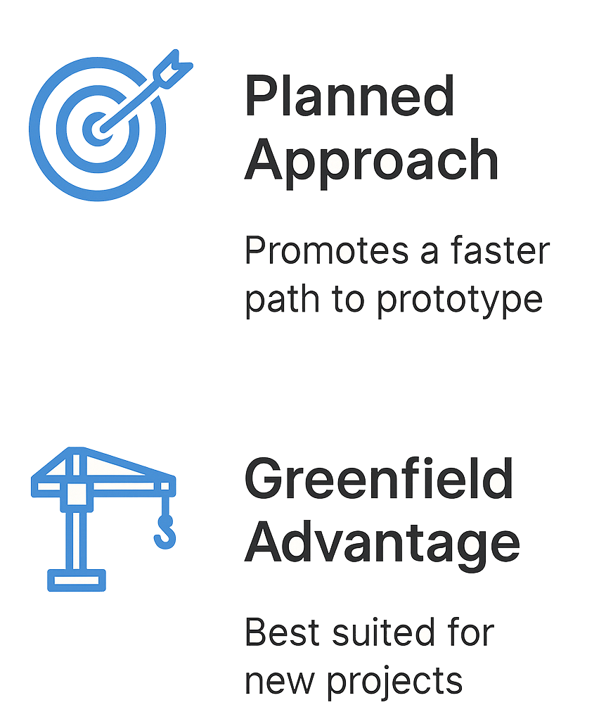
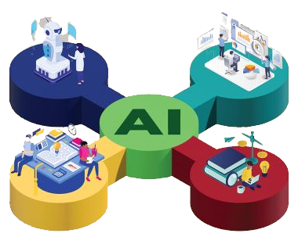
Navigating the Challenges
Notes:
--- This slide references information from the following file: https://penno365-my.sharepoint.com/personal/jgatens_upenn_edu/_layouts/15/Doc.aspx?sourcedoc=%7B86AF1ADD-D25E-4B4C-A9D7-83DF74FCA3FC%7D&file=Revised%20Senior%20HR%20Leadership%20AI%20Talk%20Meeting%20Outline%2004072025.docx&action=default&mobileredirect=true&DefaultItemOpen=1 Objective Today: To establish a shared understanding of AI's relevance to HR and initiate dialogue on a deliberate investment strategy. Connects to: "AI in HR offers potential however it must be approached with caution, transparency, & inclusivity."

Slide 5
Links
https://lovable.dev/
https://chatgpt.com/
https://gemini.google.com/app
https://claude.ai/new
https://www.langchain.com/
https://huggingface.co/
https://www.midjourney.com/
https://www.synthesia.io/
https://elevenlabs.io/
https://www.krea.ai/video
https://otter.ai/
https://www.resume-cafe.com/
https://www.oneusefulthing.org/
https://alphasignal.ai/
https://medium.com/
Notes:
--- This slide references information from the following file: https://penno365-my.sharepoint.com/personal/jgatens_upenn_edu/_layouts/15/Doc.aspx?sourcedoc=%7B86AF1ADD-D25E-4B4C-A9D7-83DF74FCA3FC%7D&file=Revised%20Senior%20HR%20Leadership%20AI%20Talk%20Meeting%20Outline%2004072025.docx&action=default&mobileredirect=true&DefaultItemOpen=1 Objective Today: To establish a shared understanding of AI's relevance to HR and initiate dialogue on a deliberate investment strategy. Connects to: "AI in HR offers potential however it must be approached with caution, transparency, & inclusivity."

Slide 6
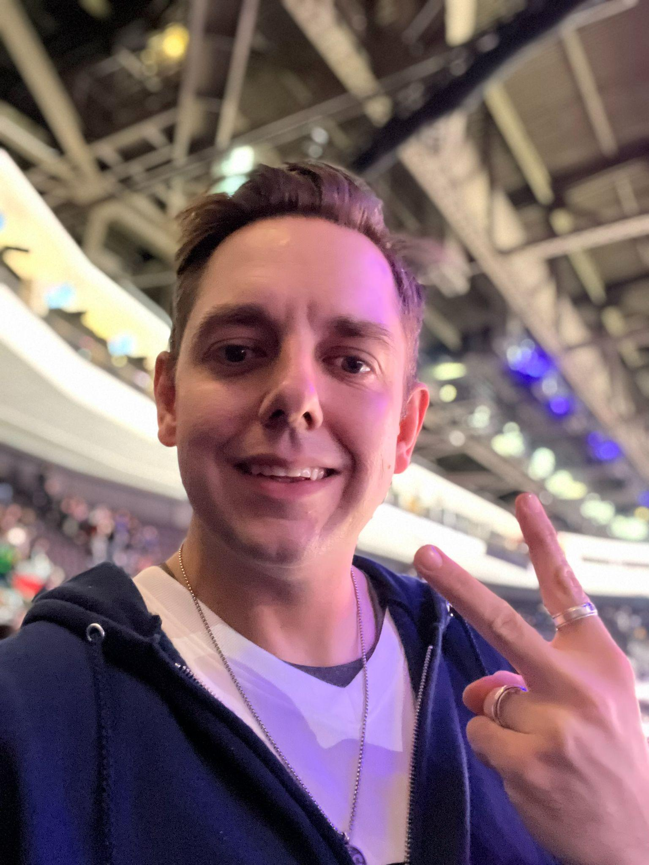
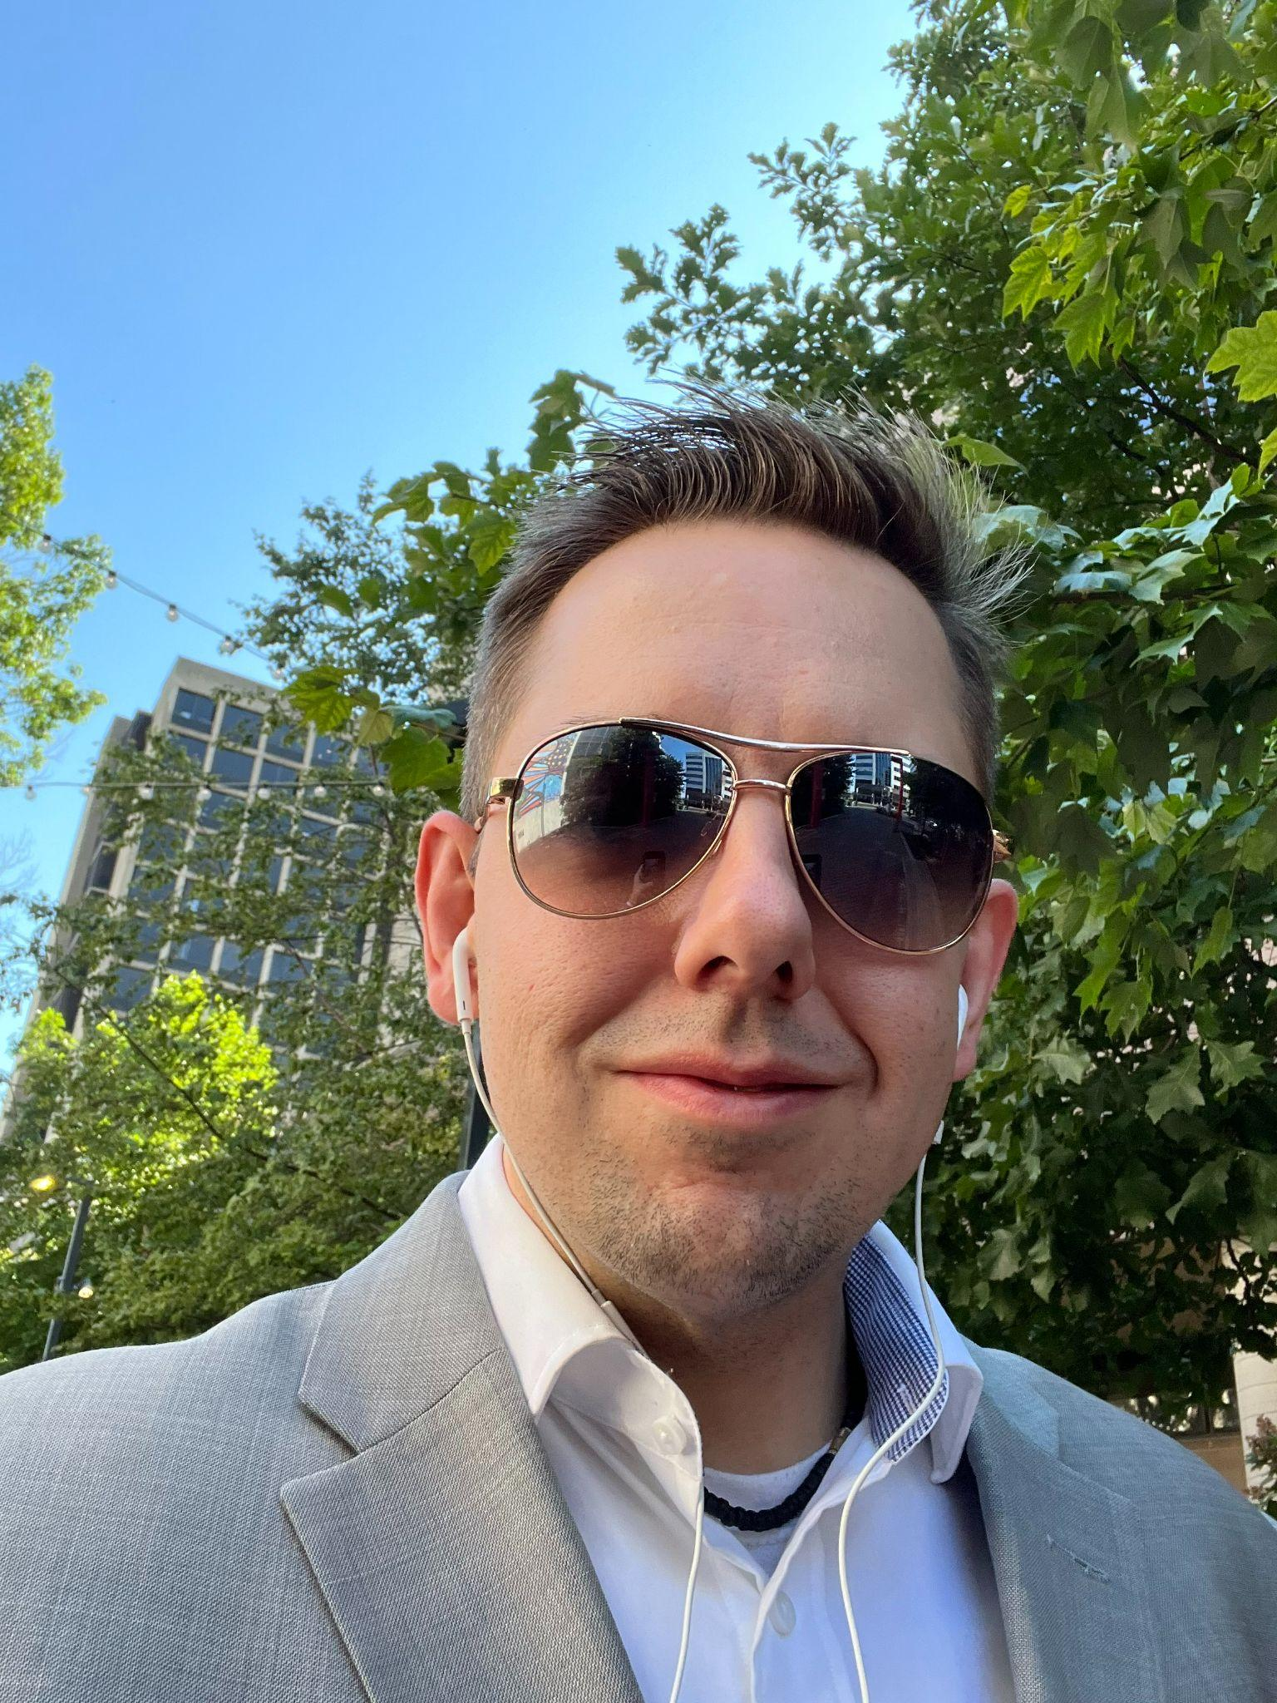
Jeremy Gatens
JeremyGatens@gmail.com
484-451-8676
linkedin.com/in/jeremy-gatens/

